Slide 1
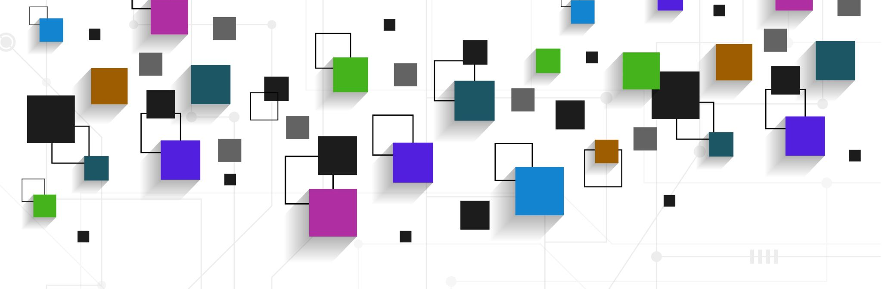
An In-Depth Analysis with Visual Representation of the Criminal Justice Systems throughout the United States
Data Analysis Team
Midterm Project Report
4/01/2021
Spring 2021
Natalie Hani nnh2@hood.edu
Lauren Thompson lmt18@hood.edu
Jonathon Wallace jw30@hood.edu
Juan Pablo Chacon jc34@hood.edu
Alex Blank adb19@hood.edu

Slide 2
The Project
Problem: Inefficient prison micro-systems within the United States that subsequently impact the macro-system as a whole.
Goal: Research the prison system in the United States as a whole and develop data analytics to study our research topic. Using specific data handling techniques on dataset, the team will investigate variables of various prisons that are inefficient and provide a final report with visual representation of the data. The team will also present a literature review discussing the topic in areas such as of previous research performed, current issues, computer science`s involvement, and the findings of the analysis on the datasets.
Research Topics:
Overcrowding in prisons
Length of stay vs. sentence length
Separation of gender
Charges and their severity
Solution: Develop an interactive visualization dashboard enabling dynamic analysis of data, highlighting the issues that occur within the prison system.

Slide 3
Background & Project Plan
We expect to share our findings through a complete literature review of all sources used throughout the project. In other words, a report that will present the need & purpose of the research, present a summary of all the data used in the report, a brief explanation of how we built our interactive dashboard and how it manages all the data, a demonstration of how our dashboard is used to analyze said data, and the conclusions drawn from our analysis.

Slide 4
Technical Description
Github: Github is a code hosting platform for version control and collaboration. It lets users and others work together on projects. By having a collective interactive dashboard through Github the team will be able to stay organized and actively provide input on different areas of the project such as datasets and source code to further analyze datasets.
D3.js: D3.js is a JavaScript library for manipulating documents that are data based. D3.js will allow the team to have interactive data visualizations in web browsers. This data-driven documents library will allow the team to bind arbitrary data to DOM. The API contains functions such as math, arrays, geometry, color, etc. to aid in the findings of data-based documents. With massive amounts of data D3.js will provide a way for said data to be visually represented.
We experimented with other platforms, such as R-Studio, which we discovered didn't quite display the data we needed in an interactive platform. R-studio displayed graphs; however, this was not enough to display the data we were looking to share.

Slide 5
Accomplished Work
Currently, we have moved towards analyzing data regarding crime rates in New York City and nationwide. When regarding the statewide crime, there were similarities between violent crime and the weapons used to commit it. We have produced a base format (.csv file), that will be processed in D3.js, that will consolidate the data of states and territories for each year. We have read related articles from the preliminary lit review and wrote an annotated bibliographies for the articles. In addition, we installed necessary components of d3.js to Github in order to start setting up the dashboard for the datasets.
What we have produced so far is good because we have a great basis on how to go about completing the rest of our research project. In addition, all team members are working from every direction to produce the dashboard and write up a literature review to share our findings.

Slide 6
Status
Repository: https://github.com/nat642/CS475.git
Datasets have been uploaded and analyzation has been begun on:
Imprison rates
Convicts held in private prison
U.S resident conviction rates
Offenses
Annotated bibliographies for sources completed
Literature Review is underway
Connecting sources to each other
Reviewing content which relates to project

Slide 7
Efforts
Team Members | Roles | Hours (Weeks1-5)
Alex Blank* | Finding Datasets, Data Analysis | 7
Jonathan Wallace* | Finding datasets, Data Analysis | 13.5
Juan Pablo Chacon* | Finding datasets, Data Analysis | 13
Lauren Thomspon* | Annotated Bibliography, Literature Review, review of data analysis in repository | 12
Natalie Hani* | Annotated Bibliography, Literature Review, review of data analysis in repository | 12
* Each member worked on the project proposal and weekly reports as well as contributed in meetings

Slide 8
Efforts
Tools
D3.js: interactive data visualizations
Python: Libraries useful to analyze data
Github: allows upload and collection of .txt and code files
Communication:
Zoom meetings throughout the week
Group chat

Slide 9
Lessons Learned
Overabundance of data collection
Data cleaning (handling missing values) and reformatting
Issues with processing of data
Consolidation of data tables into one main table, minimize the number of files to work with.
Implementing the Data with D3.js
Notes:
What went right was collection of a plethora of data, perhaps even too much data. Also cleaning the data was rather tedious but fortunately most of the data tables followed the
same format.
What went wrong was when we began to try and process the data to create visualizations with D3. It was too inefficient and time consuming to deal with all the different files which
Is where we realized that consolidating as much of the data tables as possible would be the easiest approach. Also using D3 has been a bit of a challenge as it is a new library that our group
Is not well versed with. Implementing D3 will likely require more communication with team members as we will need to help one another to tackle the issues that D3 will likely present.

Slide 10
Expected Forthcoming Activities
Completing the literature review (week 9)
Finish the consolidation of remaining data tables into one (.csv) file (week 9)
Begin (and complete) visualization of data with D3.js (week 11)
Develop interactive dashboard for the data analysis tool by using the Pyjs framework (week 11)
Complete rough draft and revisions of research paper (week 12)
Final Revised Paper (week 13)
Presentation (week 14)

